Slide 1

Cloud Computing -a brief overview
Bandenawaz Bagwan

Slide 2
Challenges in Computation
Exponential growth rate of the amount of data from various sources such as social networks, websites, emails, entertainments and so on.
Building highly scalable applications with unpredictable data traffic (volume) and demand for faster response time (velocity).
Variety of data both unstructured (images/videos) and structured (relational data).

Slide 3
Cloud Computing
Cloud Computing handles the Tera byte/Peta byte scale of data, a very reliable and scalable infrastructure is required.
Cloud Computing makes it possible by leveraging the commodity hardware thus reducing storage costs

Slide 4
Cloud Components
Clients : Clients are the devices that the end users interact with to manage their information on the cloud.
Datacenter : The datacenter is the collection of servers where the application to which we subscribe is housed.
Distributed Servers : Servers are geographically housed at different locations. As a cloud subscriber, these servers act as they are running co-located.

Slide 5
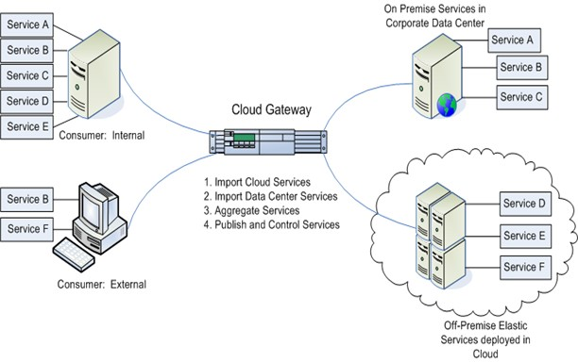
Cloud Components

Slide 6
Goals
Virtualization and abstraction of resources.
Promises to cut operational costs
Improves focus of IT departments on strategic projects instead of keeping the datacenter running.
Represents a fundamental change in how technology is used to store, computes, and delivers information

Slide 7
Benefits
Cloud is designed to be highly reliable, highly scalable, minimal support and administration costs and give more flexibility
Cloud is designed to be highly reliable, highly scalable, minimal support and administration costs and give more flexibility
Business benefits of Cloud architecture such as minimal infrastructure investment, efficient resource utilization, usage-based costing, improved scalability and response time.

Slide 8
Cloud Types
Public cloud: In Public cloud the computing infrastructure is hosted by the cloud vendor at the vendor’s premises.
Private cloud: The computing infrastructure is dedicated to a particular organization and not shared with other organizations.
Hybrid cloud: Organizations may host critical applications on private clouds and applications with relatively less security concerns on the public cloud.

Slide 9
Services In Cloud Computing
‘Services’ is the concept of reusable, fine grained components provided by a vendor’s network. Applications run on hosted servers as a service. They are classified as:
Software as a Service (SaaS)
Platform as a Service (PaaS)
Infrastructure as a Service (IaaS)

Slide 10
Cloud Computing with the Titans
Amazon
Microsoft
IBM
Oracle
EMC
Salesforce.com
NetApp

Slide 11
Cloud Architecture
Brief Overview on Amazon EMR and Windows Azure

Slide 12
Amazon Web Services
Amazon Web Services cloud provides a highly reliable and scalable platform for deploying web-scale applications.
We will discuss few key components of the AWS Cloud.
Amazon EC2 is a web service which provides resizable compute capacity in the cloud. Using web service calls, multiple instances in the cloud can be scale up or down based on the capacity requirements.

Slide 13
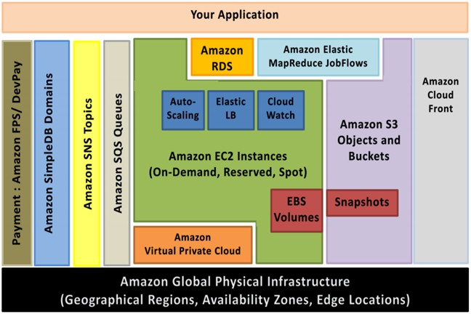
Amazon WebServices Cloud

Slide 14
Main Components of EC2
Amazon Machine Image (AMI)
Elastic Block Storage (EBS) Volume
Auto-scaling
Cloudwatch
Elastic Load Balancing

Slide 15
Amazon SQS Queues
Amazon Simple Queue Service is a messaging queue service. It handles messages or work flows between other components in the system

Slide 16
Amazon Elastic Map Reduce (EMR)
Amazon EMR is used to analyze and process high volume data.
This is done by distributing the computational work to virtual servers present in the cluster.
This cluster is managed using Apache Hadoop framework which is an open source framework from Apache.
MapReduce framework contains a Mapper class and a Reducer class.
A task is mapped to multiple servers for processing and the result of the computation performed by those servers is then reduced to a single output set.
Master node controls the distribution of tasks and the slave nodes process the data.

Slide 17
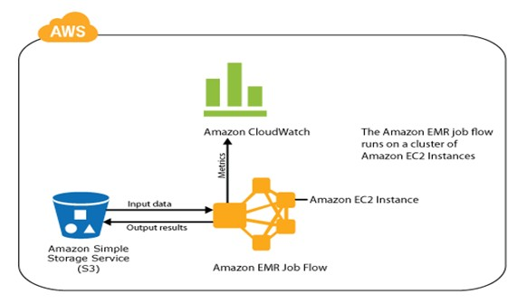
Amazon Elastic Map Reduce (EMR)

Slide 18
Architecture
Amazon EMR provides several types of clusters to run Hadoop map-reduce code.
EMR is also integrated with Apache Hive and Apache Pig.
Amazon EMR works in conjunction with Amazon EC2 instances to create a cluster.
It also uses Amazon S3 to store input data, output results, log files, scripts etc.

Slide 19
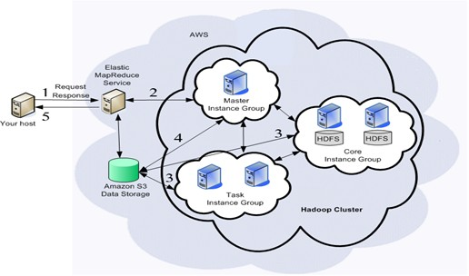
A sample set of operations in a job flow involves the following:

Slide 20
Windows Azure
Windows Azure is a comprehensive platform for developing cloud applications while providing scalability, availability and geographic distribution services.
Like EC2, Azure follows consumption based pricing model.
It is open and interoperable thus supporting multiple different technologies such as.NET, Java, Python, Ruby, and PHP.
Windows Azure is both Iaas and Paas.

Slide 21
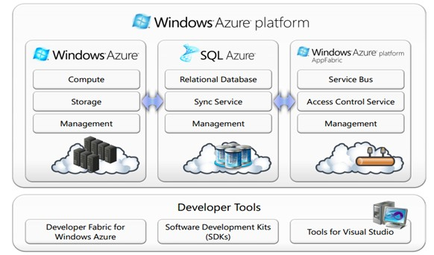
Windows Azure

Slide 22
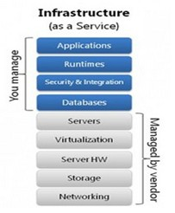
Architecture Comparison
Amazon Vs Azure Amazon Web Services offers a Iaas (Infrastructure as a Service) whereas Windows Azure offers Platform as a Service(PaaS).

Slide 23
Cloud Storage
Brief overview on AWS

Slide 24
Amazon AWS Storage options
Amazon EC2 Elastic Block Storage (EBS) volumes
Amazon EC2 Local Instance Store (Ephemeral) volumes
Amazon Simple Storage Service (Amazon S3)
Amazon Simple Queue Service (SQS)
Amazon SimpleDB
Amazon EC2 Relational Databases
Amazon Relational Database Service (RDS)

Slide 25
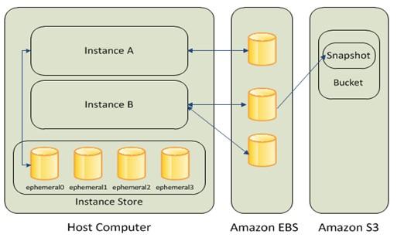
Amazon AWS Cloud Storage

Slide 26
Cloud Security
Brief overview on Amazon cloud security

Slide 27
AWS Security Process
Amazon EC2 Security
Instance Isolation
Host Operating System
Guest Operating System
Firewall
Elastic Block Storage (Amazon EBS) Security
Amazon Elastic Load Balancing Security
Amazon Simple Storage Service (S3) Security
Amazon Relational Database Service (RDS) Security

Slide 28
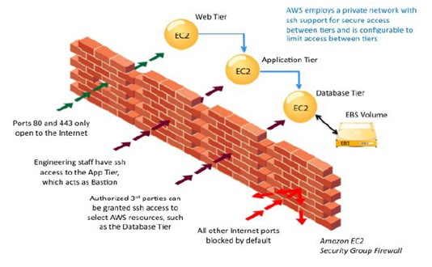
Amazon Cloud Security

